Slide 1
HAD-Jek :
Ojek Online
Hilman Maulana Anhar
Muhamad Dani Setiawan
M Naufal Azmi
1SC8

Slide 2
What is HAD-Jek ?

Slide 3

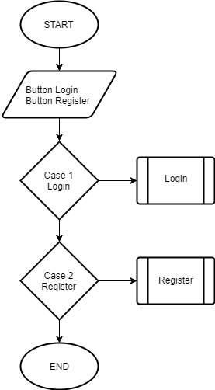
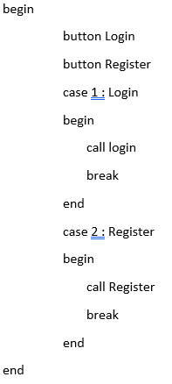
INDEX
FLOWCHART
PSEUDOCODE

Slide 4
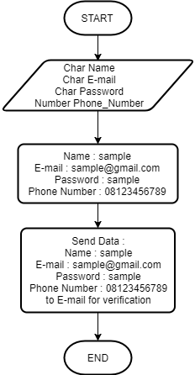
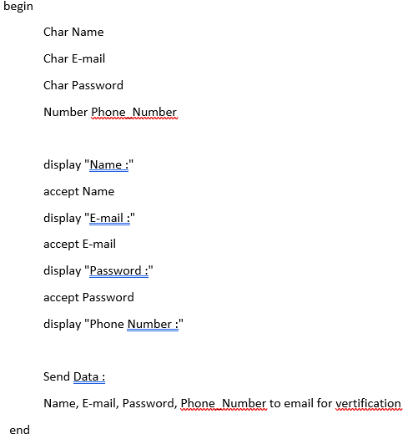
REGISTER
FLOWCHART
PSEUDOCODE

Slide 5
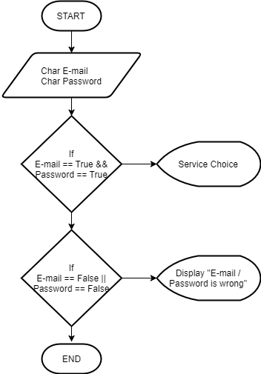
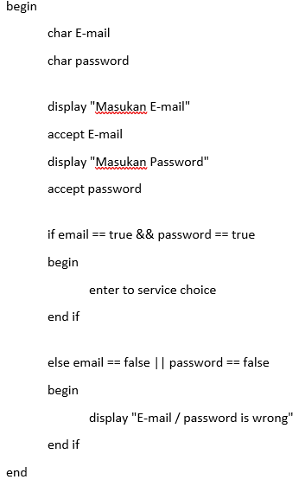
LOGIN
FLOWCHART
PSEUDOCODE

Slide 6
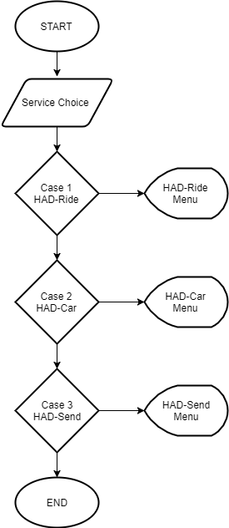
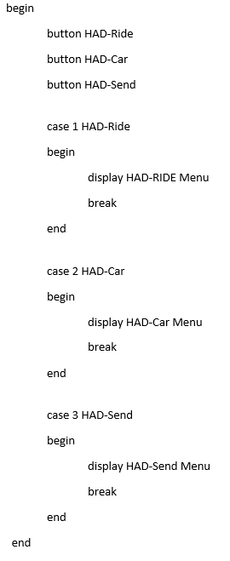
SERVICE MENU
FLOWCHART
PSEUDOCODE

Slide 7
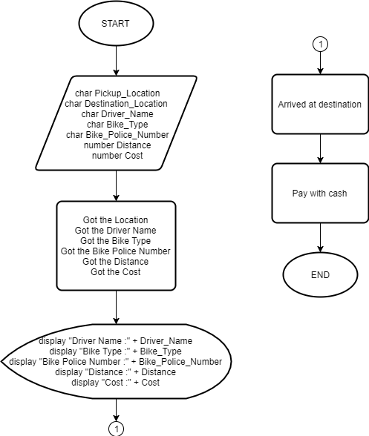
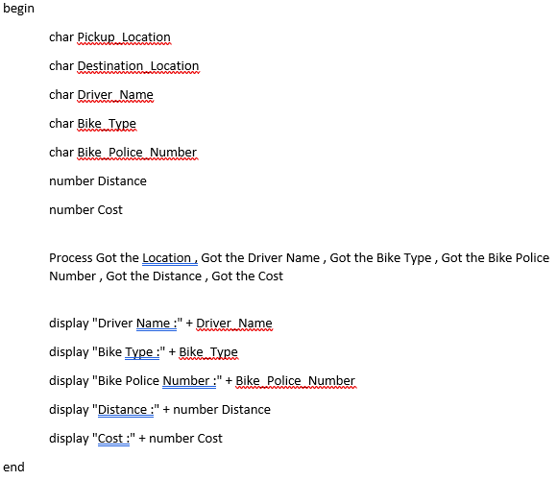
HAD-Ride Service
FLOWCHART
PSEUDOCODE

Slide 8
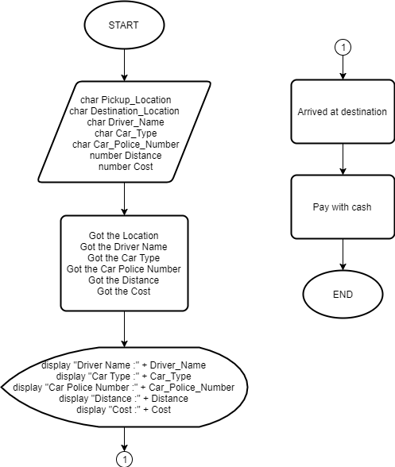
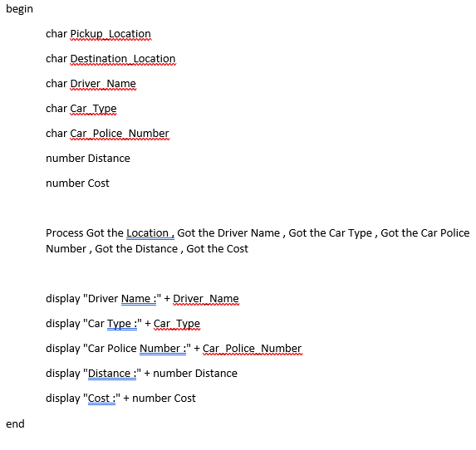
HAD-Car Service
FLOWCHART
PSEUDOCODE

Slide 9
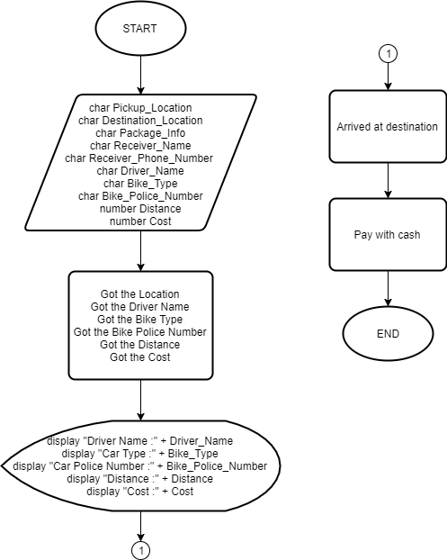
HAD-Send Service
FLOWCHART
PSEUDOCODE

Slide 10
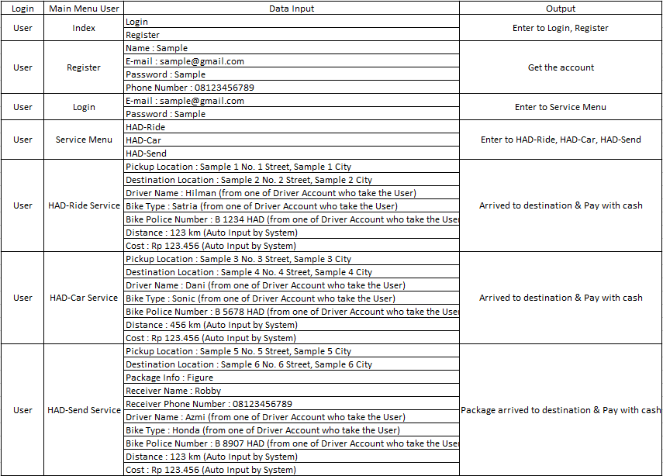
Dry Run Table

Slide 11
CONCLUSION AND SUGGESTION
CONCLUSION
SUGGESTION
Network is a Collection of devices that connected to one another, thus creating an integrated connection, in order to create a network, first thing is to overlook a Topology and the Architecture and decide the media and device used within the Network.
Even with the Complexity of the Network setup, it can not guaranteed 100% safety, to anticipate it is recommended for the Administrators to perform a weekly data backup, to anticipate the Network Failure caused by user error or a Natural Disaster.

Slide 12
THANK YOU ☺
ANY QUESTIONS?

